Slide 1
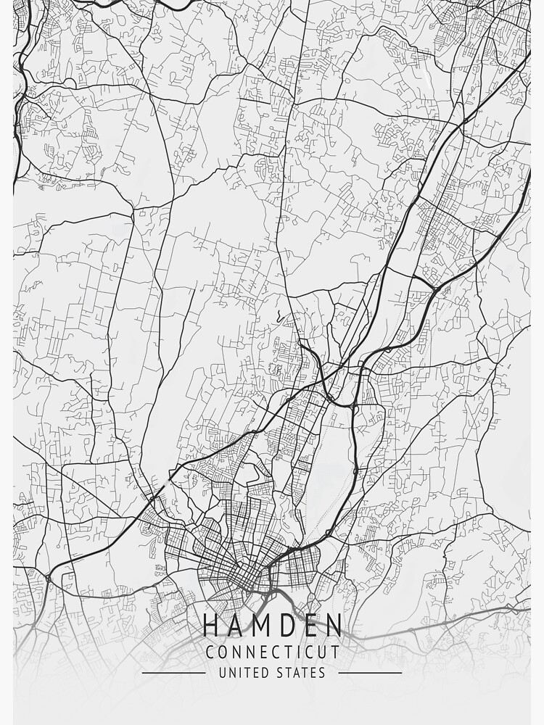





WELCOME
HAMDEN NEWHALL NEIGHBORHOOD ASSOCIATION
April 23, 2026
Notes:
5 Minutes for HNNA representatives to introduce themselves and open up the discussion.

Slide 2


HAMDEN NEWHALL NEIGHBORHOOD ASSOCIATION (HNNA)
Executive Board
Tina Jennings-Harriott, President
Tonya Campbell, Vice President
Danielle Campbell, Secretary
Belinda Robinson, Treasurer
Denise Burns, Member at Large
Barbara Coxum, Member
Joseph Carr, Member
Penney Toney, Member
Key Aspects of the HNNA Mission:
Infrastructure Repair & Advocacy
A primary focus is securing, organizing, and advocating for necessary funding to address long-term, structural, and environmental issues within the Newhall neighborhood.
Community Empowerment
The group organizes residents to create a unified voice in local government meetings and decision-making processes.
Partnership
The association collaborates with organizations like CONECT (Congregations Organized for a New Connecticut) and state officials to ensure the voices of Newhall residents are heard.
Notes:
5 Minutes to discuss who they are and introduce the agenda, their individual participants and the team

Slide 3

NEWHALL FOUNDATIONS MIDDLE SCHOOL DEMOLITION
CAROL HAZEN
STEPHEN WHITE, PE
TOWN OF HAMDEN
Director, Grants & Capital Projects/Project Manager
TOWN OF HAMDEN
Town Engineer/ Project Manager
TIM BARRY
7 SUMMITS CONSTRUCTION
Project Manager
TIM BARRY
CHRIS HARRIMAN, LEP
7 SUMMITS CONSTRUCTION
Project Manager
HALEY & ALDRICH
Project Manager
JEREMY HAUGH, PE
SAM HAYDOCK, LEP
HALEY & ALDRICH
Project Manager
BL COMPANIES
Project Manager
LEAH BERLIN, EIT
For Middle School Project updates please visit:
https://www.hamden.com/893/Former-Hamden-Middle-School-Michael-J-Wh
Reach out to Stephen White with further questions:
engineering@hamden.com
HALEY & ALDRICH
Project Manager
For Foundation Project updates please visit: https://www.hamdenedc.com/
Reach out to Carol Hazen with further questions: chazen@hamden.com
Notes:
5 Minutes for HNNA representatives to introduce panelists, each panelist needs to say what their company does and introduce themselves

Slide 4
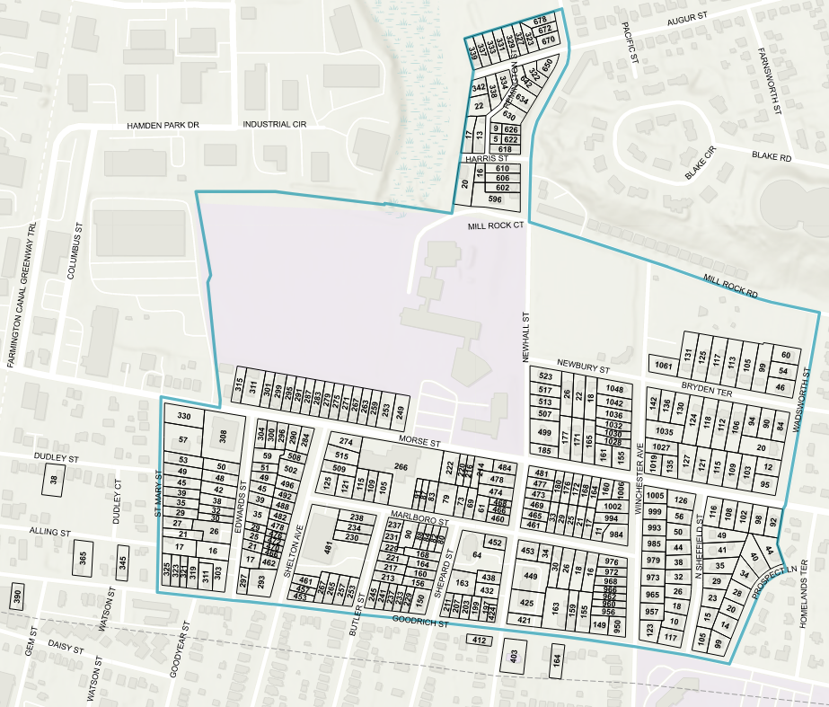
NEWHALL FOUNDATIONS REPAIR PROJECT UPDATES
Condition Assessments – 100% Complete
Subsurface Investigations – 92% Complete
Design Repairs and Reports – 50 % Complete
Construction Documents – 30% Complete
Haley & Aldrich issued 18 sets of Construction Documents for review and bidding in March
Upon review and acceptance by applicable agencies, up to 10 properties will be selected for continuity and commonality for 1st phase bidding.
Notes:
H&A recommends moving this slide before 13, H&A will focus on presenting pe-construction and design work

Slide 5
SEQUENCE FOR A TYPICAL NON-STRUCTURAL PROPERTY
Homeowner Responds to Outreach and Provides Information
2. Engineering Assessment of Property
3. Homeowner is Informed of Property Eligibility
4. Survey of Eligible Properties
  A-2 surveys of work to be performed near property lines.
  All impacted properties to have offsets and elevation benchmarks.
5. Homeowner is Informed of Eligible Repairs and Accepts Construction Documents are Prepared
  Construction Documents are released to applicable agencies for review (7 Summits, SHPO, DECD, Hamden).
  Repairs are bid and qualified contractors are selected.
  Owner receives details about the repair process, schedule and agrees to the repairs.
6. 7 Summits Construction Initiates Site Logistics
  Collaborates with homeowner for staging and setup of materials and equipment
7. Construction and Oversight
  7 Summits manages repair procedures on individual properties, scheduling and documenting all work performed.
  Maintains daily logs.
  Daily communication with homeowner on status of work being performed.
8. Unforeseen Issues and Changes are Addressed
  Unknown conditions documented, discussed with Town, and processed for review.
9. Owner, Town, and Engineer Accept Satisfactory Repair Work
  Certificate of Compliance issued by Town of Hamden Building and Engineering Departments.
Notes:
2 Minutes – H&A – HA role, scope of project and your role on it, the status of your work

Slide 6
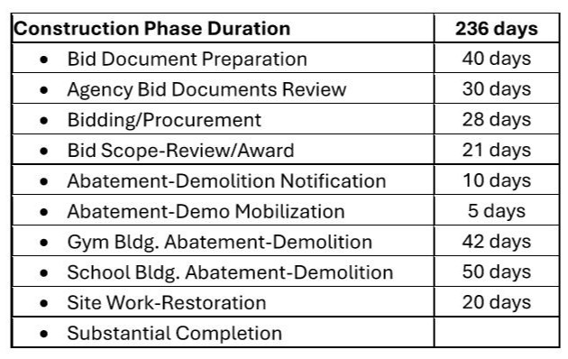
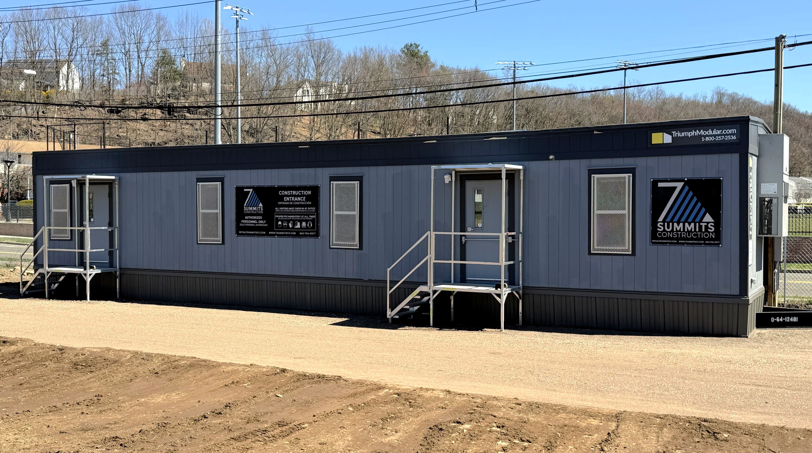
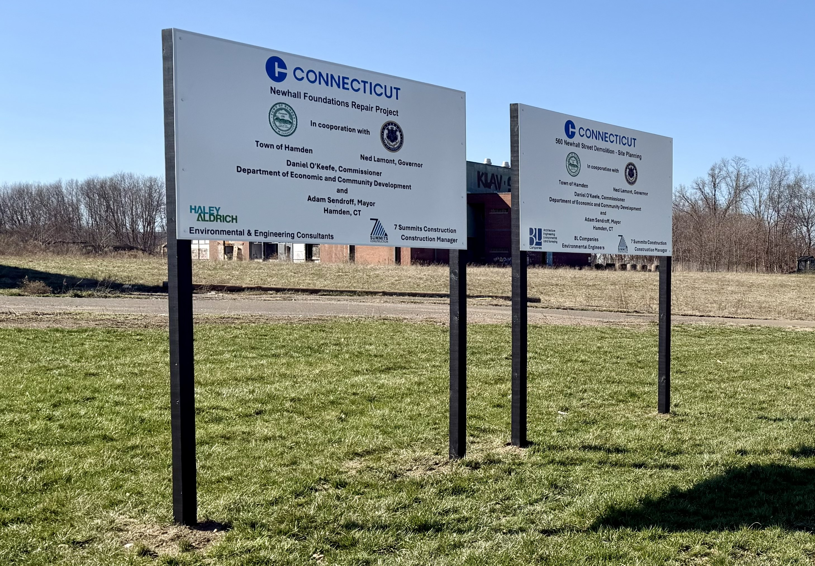
MIDDLE SCHOOL DEMOLITION PROJECT
Notes:
2 Minutes – BL – BL role, scope of project and your role on it, the status of your work

Slide 7
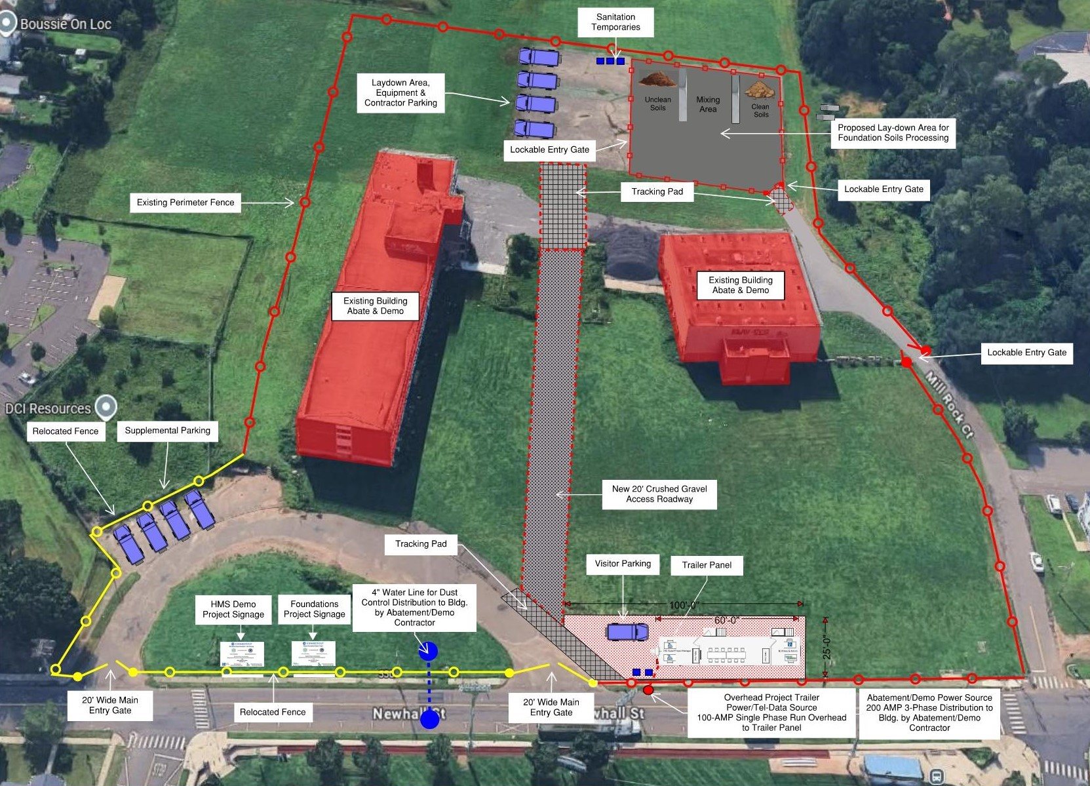
MIDDLE SCHOOL DEMOLITION PROJECT
Current Activities & Logistics Plan
Site security/safety fencing relocated
Construction trailer delivered & set-up
Temporary electric service installed
Project signage installed
Notes:
3 Minutes – 7SC – 7SC role, our process for communication, homeowner considerations and plans, phasing,

Slide 8


THANK YOU FOR COMING TO LEARN MORE ABOUT THESE IMPORTANT PROJECTS
  Questions submitted this evening will be answered next.
  Questions from the floor will be limited to 3 minutes to encourage participation.
  Unanswered questions will be addressed at next community meeting.
  Additional questions may be emailed to hnnassoc@gmail.com
  To receive a home assessment please contact Leah Berlin at lberlin@haleyaldrich.com
Notes:
5 Minutes – HNNA opens it up for questions

Slide 9
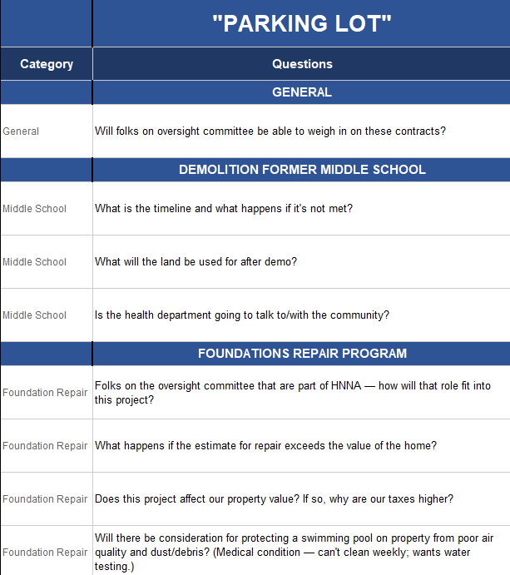
Notes:
5 Minutes – HNNA opens it up for questions

