Slide 1
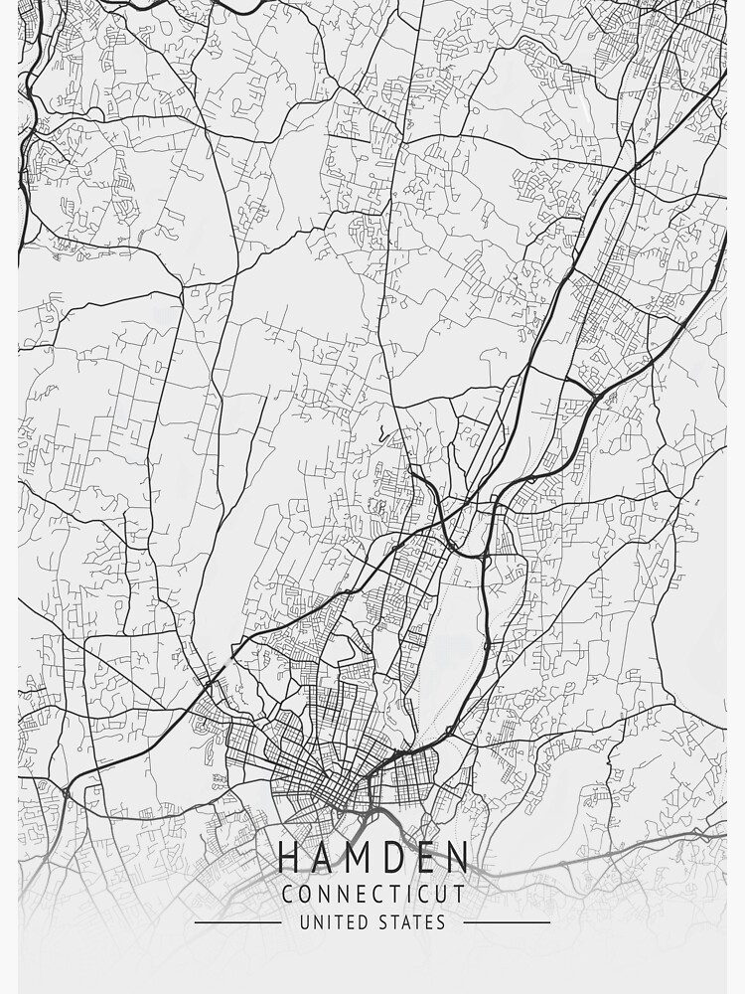





WELCOME
HAMDEN NEWHALL NEIGHBORHOOD ASSOCIATION
February 19, 2026
Notes:
5 Minutes for HNNA representatives to introduce themselves and open up the discussion.

Slide 2


HAMDEN NEWHALL NEIGHBORHOOD ASSOCIATION (HNNA)
Executive Board
Tina Jennings-Harriott, President
Tonya Campbell, Vice President
Danielle Campbell, Secretary
Belinda Robinson, Treasurer
Denise Burns, Member at Large
Barbara Coxum, Member
Joseph Carr, Member
Penney Toney, Member
Key Aspects of the HNNA Mission:
Infrastructure Repair & Advocacy
A primary focus is securing, organizing, and advocating for necessary funding to address long-term, structural, and environmental issues within the Newhall neighborhood.
Community Empowerment
The group organizes residents to create a unified voice in local government meetings and decision-making processes.
Partnership
The association collaborates with organizations like CONECT (Congregations Organized for a New Connecticut) and state officials to ensure the voices of Newhall residents are heard.
Notes:
5 Minutes to discuss who they are and introduce the agenda, their individual participants and the team

Slide 3

HAMDEN NEWHALL NEIGHBORHOOD ASSOCIATION (HNNA)
  Overview of HNNA
  Town of Hamden Responsibilities
  Foundations Project Overview
  Middle School Demolition Overview
  Q&A – Guidelines for Engagement
Notes:
5 Minutes to discuss who they are and introduce the agenda, their individual participants and the team

Slide 4

PANELISTS
NEWHALL FOUNDATIONS PROJECT
MIDDLE SCHOOL DEMOLITION
CAROL HAZEN
STEPHEN WHITE, PE
TOWN OF HAMDEN
Director, Grants & Capital Projects/Project Manager
TOWN OF HAMDEN
Town Engineer/ Project Manager
TIM BARRY
7 SUMMITS CONSTRUCTION
Project Manager
TIM BARRY
CHRIS HARRIMAN, LEP
7 SUMMITS CONSTRUCTION
Project Manager
HALEY & ALDRICH
Project Manager
JEREMY HAUGH, PE
SAM HAYDOCK, LEP
HALEY & ALDRICH
Project Manager
BL COMPANIES
Project Manager
LEAH BERLIN, EIT
HALEY & ALDRICH
Project Manager
Notes:
5 Minutes for HNNA representatives to introduce panelists, each panelist needs to say what their company does and introduce themselves

Slide 5
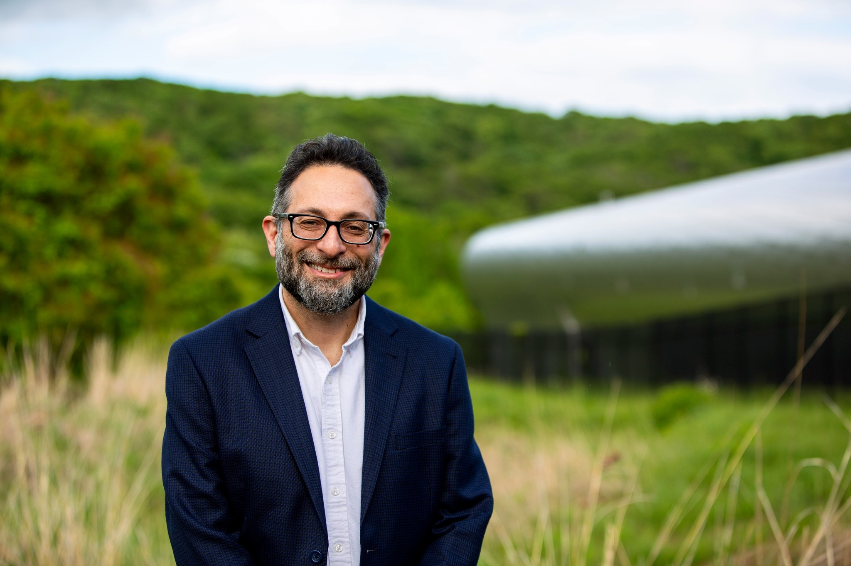

TOWN OF HAMDEN
Mayor Sendroff
Project Goals
Town’s Role
Personal Commitment
Notes:
5 Minutes -

Slide 6
TOWN OF HAMDEN
CAROL HAZEN
Director, Grants & Capital Projects/Project Manager
NEWHALL FOUNDATIONS PROJECT
STEPHEN WHITE, PE
Town Engineer/Project Manager
MIDDLE SCHOOL DEMOLITION PROJECT
Project History
Next Steps
Survey Results
Notes:
12 Minutes – 2 Min Carol to open and provide graphic of survey results, then 5 minutes each for Carole and Stephen to give project description and schedule for each project (BIG PICTURE)

Slide 7
TOWN OF HAMDEN
NEWHALL FOUNDATIONS REPAIR PROJECT
CAROL HAZEN
Project Manager
  Foundation Repair and Community Stabilization Program
    Eligibility requirements are evidence of foundation settlement associated with CT DEEP-identified waste fill or problems associated with past environmental remediation
  Budget: $17,970,152
    $1,800,000 (ARPA)
    $8,000,000 (DECD CIF R7)
    $8,170,152 (Local funds)
  Phased Approach to Repairs
  Next Steps – Bid plans in early 2026. Begin repairs summer 2026.
For project updates please visit: https://www.hamdenedc.com/
Reach out to Carol Hazen with further questions: chazen@hamden.com
Notes:
5 minutes each for Carole and Stephen to give project description and schedule for each project (BIG PICTURE)

Slide 8
TOWN OF HAMDEN
MIDDLE SCHOOL DEMOLITION PROJECT
STEPHEN WHITE, PE
Town Engineer/Project Manager
  Project History
    Began planning in 2022
    RFP issued in 2023
    Consultant team on board in 2024
    Scope change to full demolition of all buildings in 2025
    Full demolition plans complete in early 2026
  Funding Sources:
    $5,400,000 (DECD)
    $825,000 (Local Funds)
    $200,000 (CDBG)
    Total - $6,425,000
  Implement Approach to Demolition & Abatement
  Next Steps – Bid Plans in 2026. Begin work in 2026.
For further questions and concerns, please reach out to: engineering@hamden.com
Project page: https://www.hamden.com/893/Former-Hamden-Middle-School-Michael-J-Wh
Notes:
5 minutes each for Carole and Stephen to give project description and schedule for each project (BIG PICTURE)

Slide 9
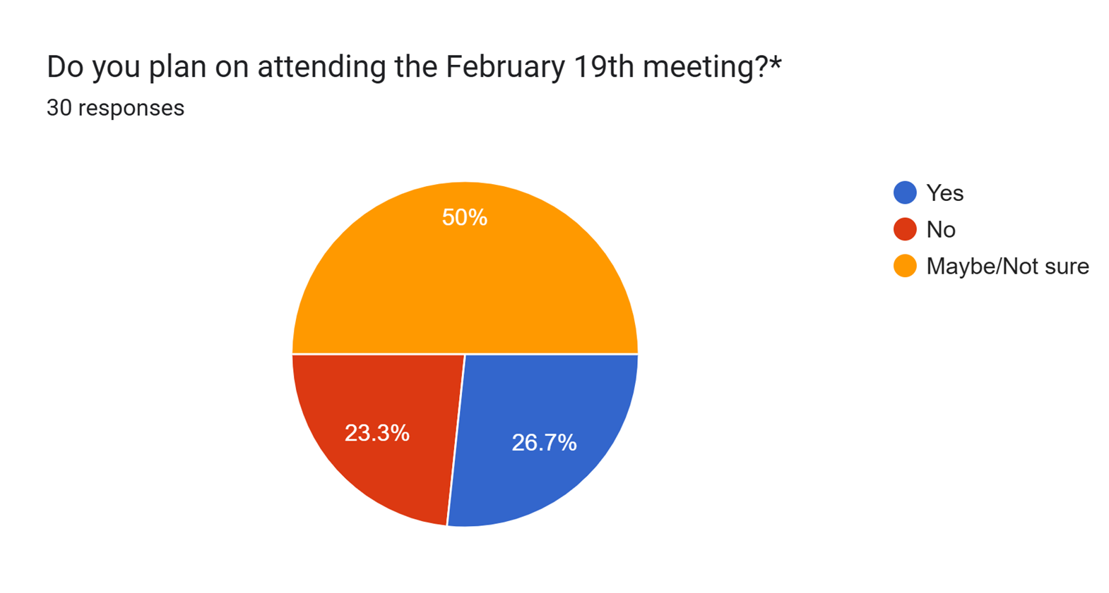
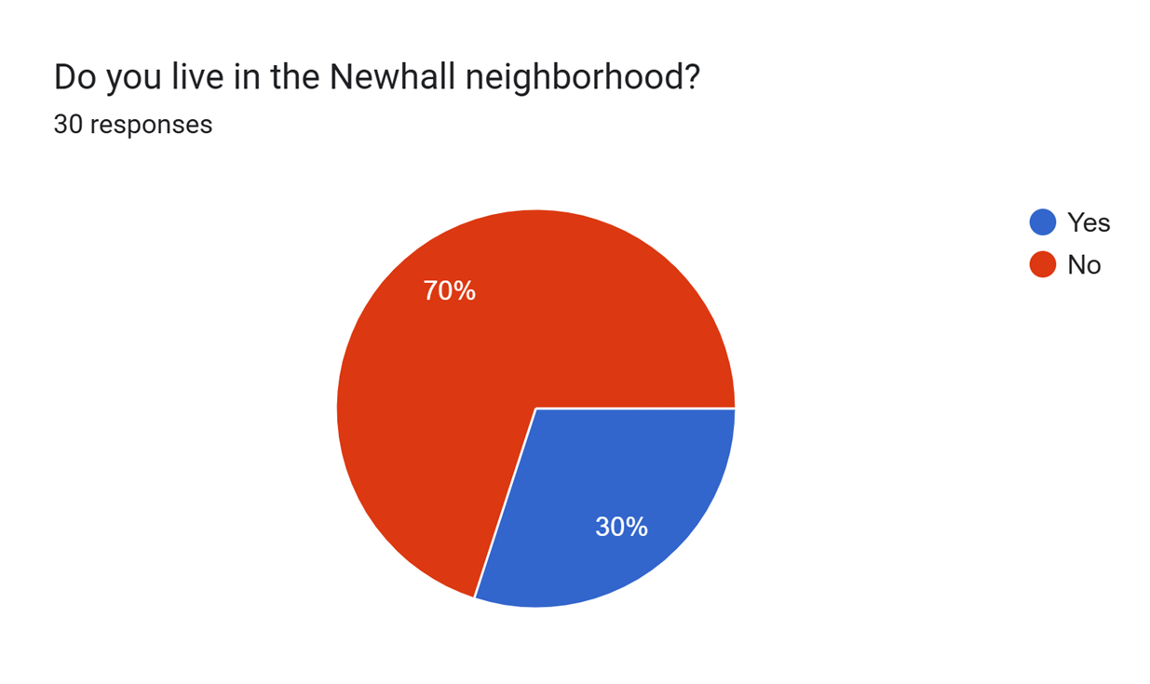
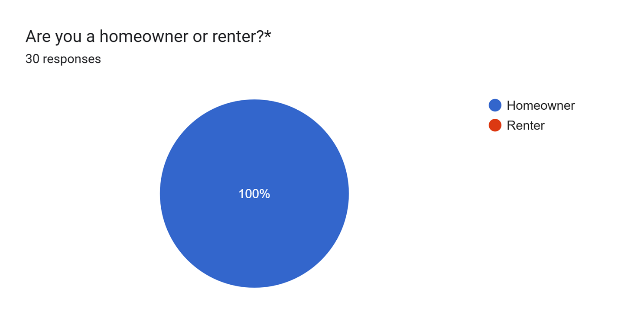
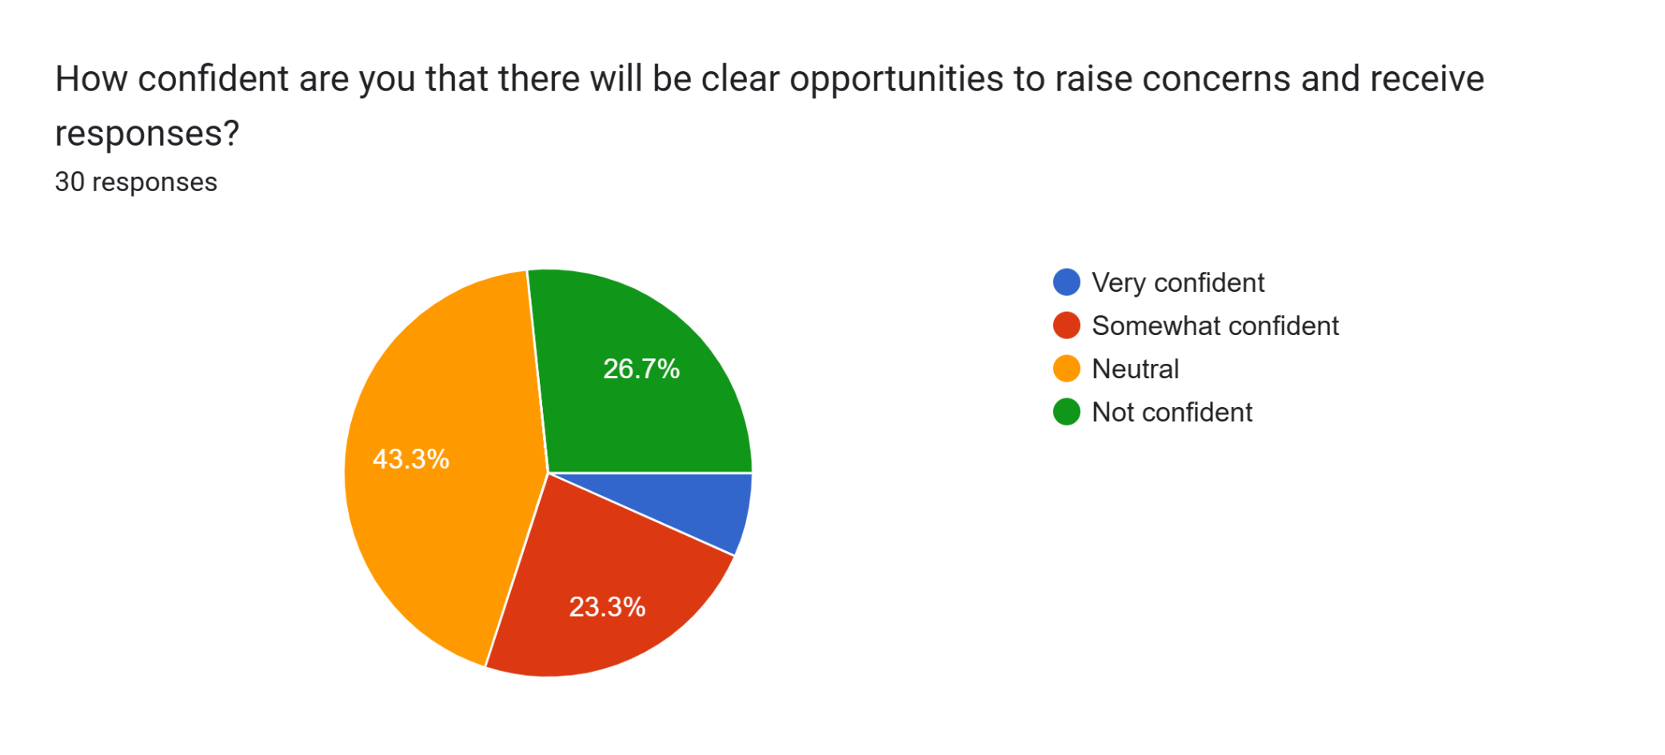
TOWN OF HAMDEN
Community Survey
I
Notes:
2 Min Carol to provide graphic of survey results

Slide 10
TOWN OF HAMDEN
Community Survey
What questions or concerns do you have about the Newhall Foundations Repair Project?
Environmental Impacts – 7 (23.3%)
Noise – 2 (6.7%)
Daily Disruption – 3 (10%)
Pest Control – 3 (10%)
Vibrations Impact – 3 (10%)
Air Quality/Dust – 8 (26.7%)
Temporary Relocation – 2 (6.7%)
Unexpected Costs to Homeowner – 8 (26.7%)
Project Timeline – 7 (23.3%)
Communication and Updates – 3 (10%)
Quality of Repair Work – 8 (26.7%)
Project Oversight/Quality Control – 7 (23.3%)
How Succes Will Be Measured – 4 (13.3%)
No Concerns – 5 (16.7%)
Who is Paying – 1 (3.3%)
Additional Damage – 1 (3.3%)
Notes:
2 Min Carol to provide graphic of survey results

Slide 11
TOWN OF HAMDEN
Community Survey
What questions or concerns do you have about the Demolition of the former middle school?
Environmental Impacts – 13 (43.3%)
Noise – 4 (13.3%)
Daily Disruption – 3 (10%)
Pest Control – 4 (13.3%)
Vibrations Impact – 4 (13.3%)
Air Quality/Dust – 10 (33.3%)
Project Timeline – 9 (30%)
Tax Dollars to Homeowners – 1 (3.3%)
Who is Paying – 1 (3.3%)
Communication – 3 (10%)
Safety During Construction – 1 (3.2%)
Quality of Work – 2 (6.7%)
Project Oversight/Quality Control – 8 (26.7%)
How Success Will Be Measured – 6 (20%)
No Concerns – 2 (6.7%)
Are there environmental hazards – 1 (3.3%)
What will be put in its place – 1 (3.3%)
Notes:
2 Min Carol to provide graphic of survey results

Slide 12
NEWHALL FOUNDATIONS REPAIR PROJECT
CHRIS HARRIMAN, LEP JEREMY HAUGH, PE
Project Managers
Haley & Aldrich
Design & Evaluation Process
Property Eligibility & Identified Issues
Progress Updates
Notes:
H&A recommends moving this slide before 13, H&A will focus on presenting pe-construction and design work

Slide 13
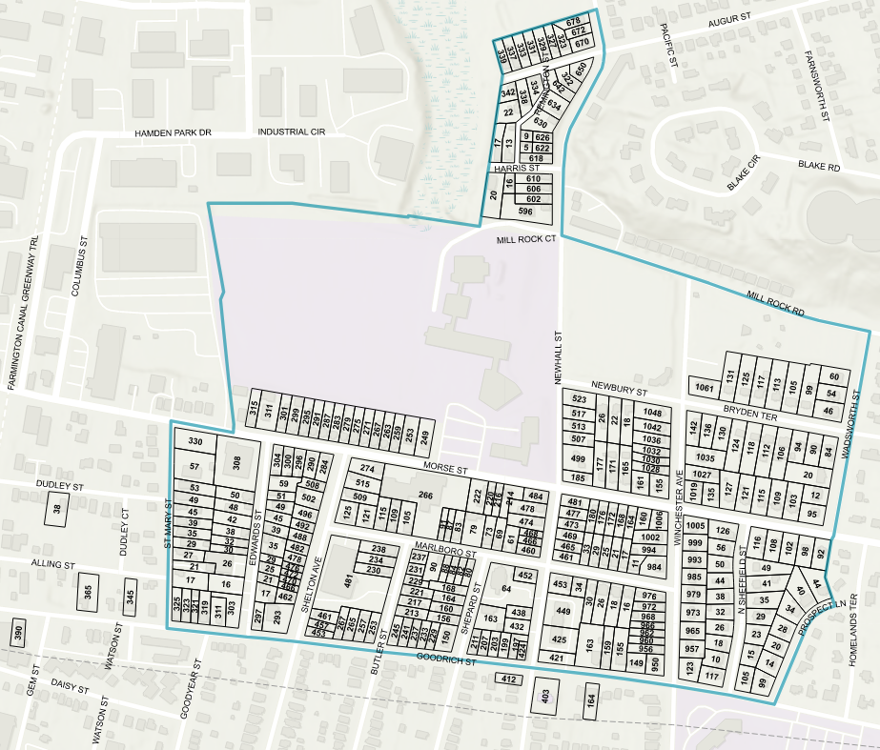
NEWHALL FOUNDATIONS REPAIR PROJECT
Notes:
Removed extra text, H&A will present on eligibility of properties and discuss COB (boundary)

Slide 14
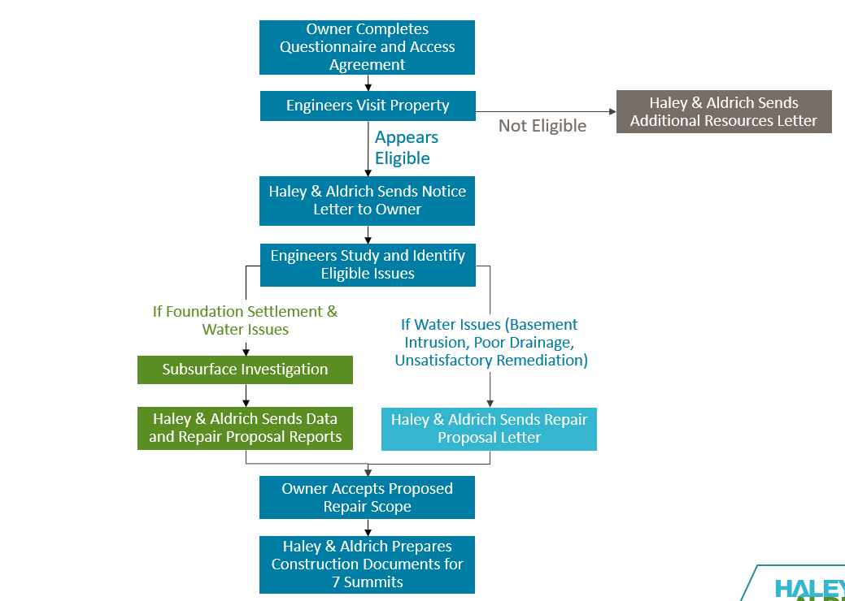
NEWHALL FOUNDATIONS REPAIR PROJECT
Haley & Aldrich Process
CHRIS HARRIMAN, LEP
JEREMY HAUGH, PE
Project Managers
Haley & Aldrich
If you have questions, please see Leah Berlin at the Haley & Aldrich table after the presentation or email: lberlin@haleyaldrich.com
Notes:
2 Minutes – H&A – HA role, scope of project and your role on it, the status of your work

Slide 15
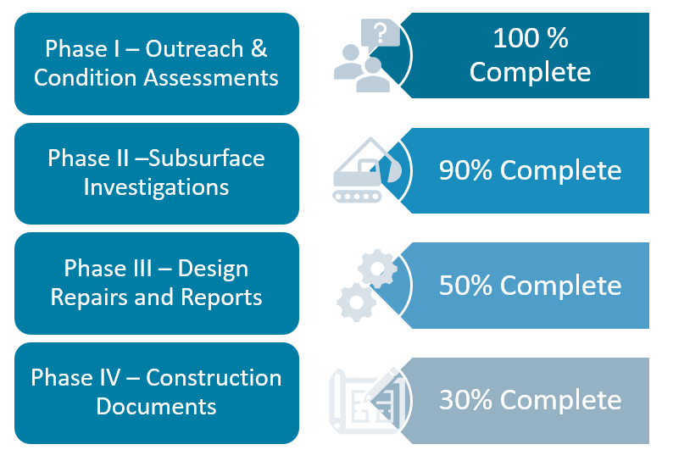
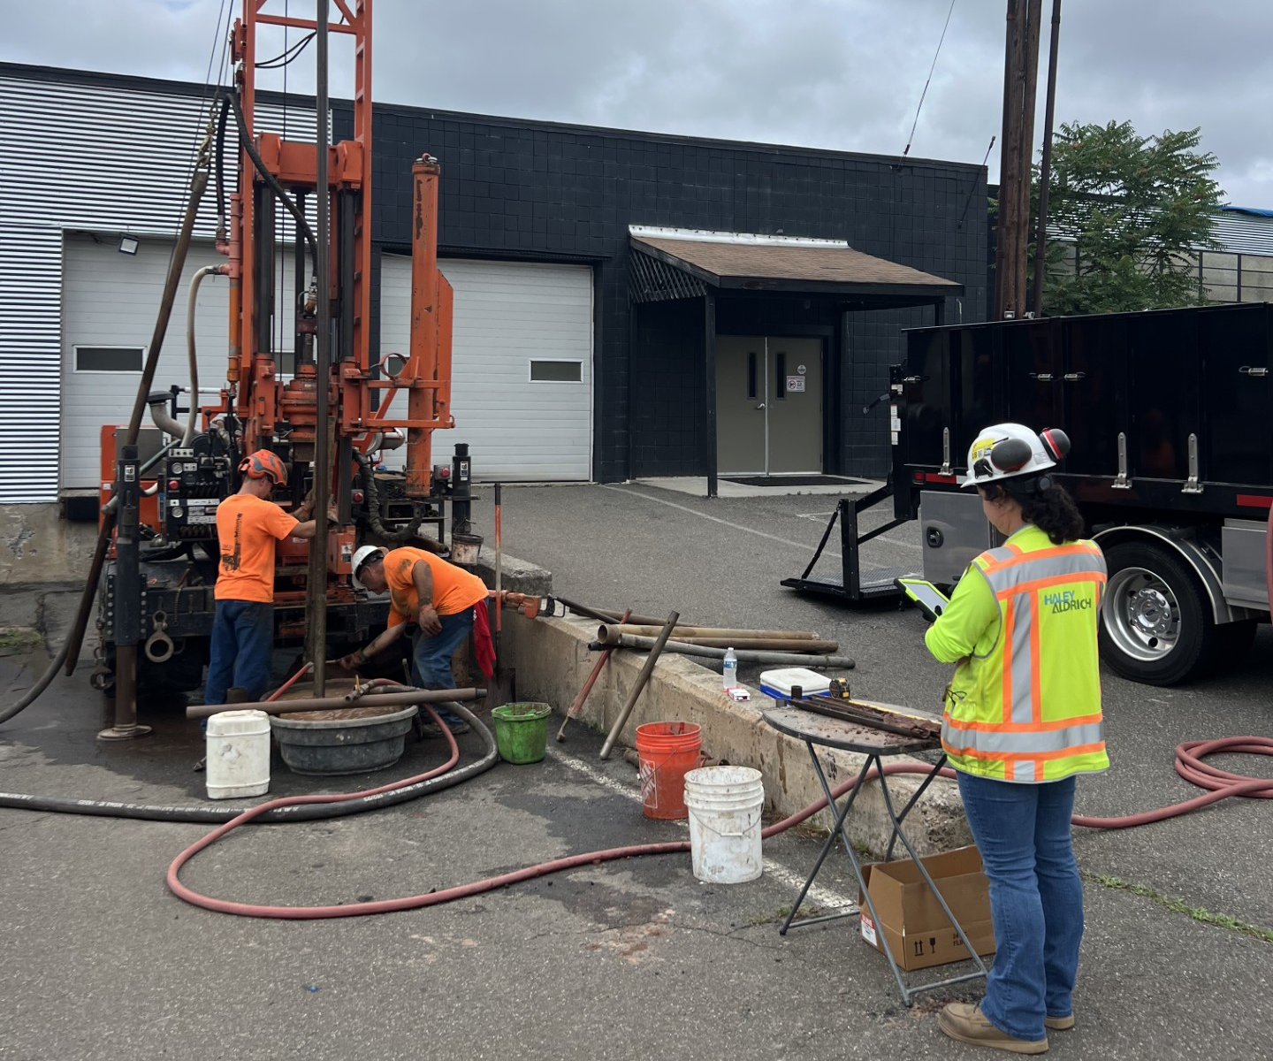
NEWHALL FOUNDATIONS REPAIR PROJECT
Haley & Aldrich Progress
CHRIS HARRIMAN, LEP
JEREMY HAUGH, PE
Project Managers
Haley & Aldrich
Questionnaires Sent: 305 (6 Rounds of Outreach)
Questionnaires Received: 188
Condition Assessments Completed/Requested: 145/158
Eligible Properties: 75
Subsurface Investigations Completed: 32
Repair Proposal Letters Accepted/Sent: 23/36
If you have questions, please see Leah Berlin at the Haley & Aldrich table after the presentation or email: lberlin@haleyaldrich.com
Notes:
2 Minutes – H&A – HA role, scope of project and your role on it, the status of your work

Slide 16
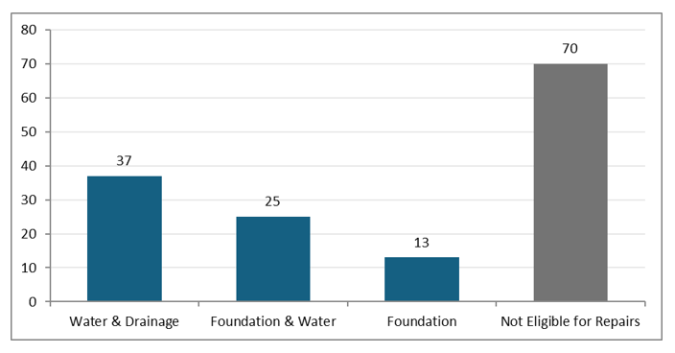
NEWHALL FOUNDATIONS REPAIR PROJECT
Property Eligibility & Identified Issues
CHRIS HARRIMAN, LEP
JEREMY HAUGH, PE
Project Managers
Haley & Aldrich
Notes:
2 Minutes – H&A – HA role, scope of project and your role on it, the status of your work

Slide 17
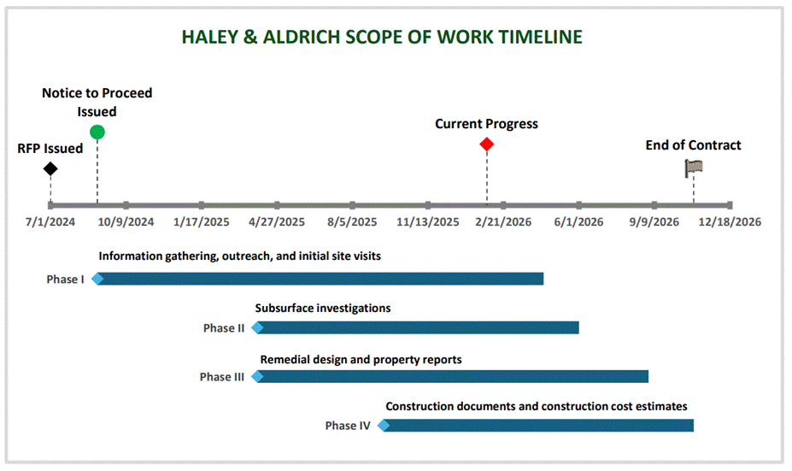
NEWHALL FOUNDATIONS REPAIR PROJECT
Preconstruction Timeline
CHRIS HARRIMAN, LEP
JEREMY HAUGH, PE
Project Managers
Haley & Aldrich
Notes:
2 Minutes – H&A – HA role, scope of project and your role on it, the status of your work

Slide 18
NEWHALL FOUNDATIONS REPAIR PROJECT
TIM BARRY
Project Manager
7 Summits Construction
Current Activities
Next Steps
Schedule & Logistics Plan
Notes:
2 Minutes – 7SC – 7SC role, our process for communication, homeowner considerations and plans, phasing,

Slide 19

NEWHALL FOUNDATIONS REPAIR PROJECT
Current Activities
TIM BARRY
Project Manager
7 Summits Construction
  Reviewing Preliminary Documents from Haley & Aldrich
  Determine Scopes of Work and Develop Bid Packages
  Bid Phase, Scope Reviews & Awards
  Homeowner Questionnaire to Learn About Access / Needs During Construction
Notes:
3 Minutes – 7SC – 7SC role, our process for communication, homeowner considerations and plans, phasing,

Slide 20
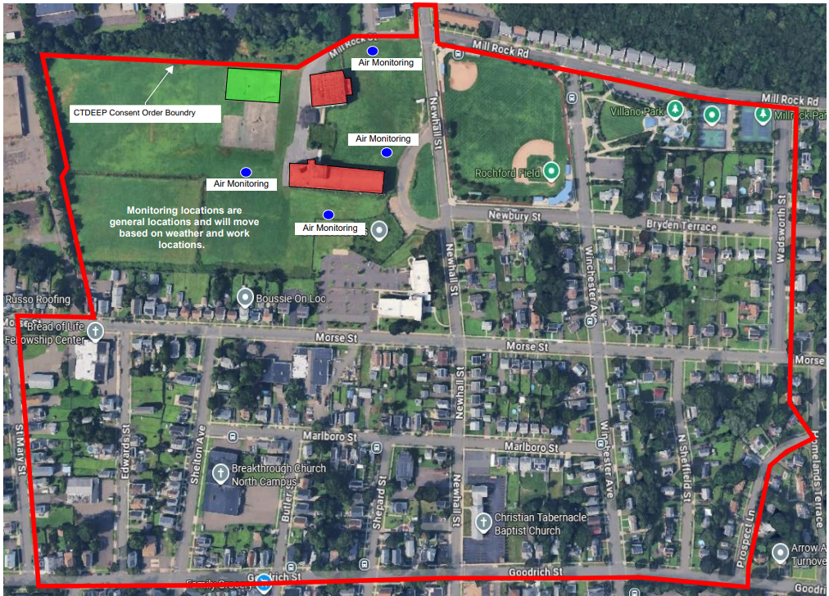
NEWHALL FOUNDATIONS REPAIR PROJECT
Next Steps / Schedule
TIM BARRY
Project Manager
7 Summits Construction
  Next Steps & Construction
  Job Site Mobilization (concurrent with Middle School Demo / Abatement)
  Complete First Phase of Drainage Projects
    Approx 15 Homes Late 2026
AIR MONITORING
CT DEEP CONSENT ORDER BOUNDARY
AIR MONITORING
AIR MONITORING
Monitoring Locations Are General Locations and Will Move Based On Weather and Work Locations
Newbury Street
Bryden Terrace
Wadsworth Street
AIR MONITORING
Newhall Street
Morse Street
Morse Street
Edwards Street
Shelton Ave
Marlboro Street
Winchester Ave
N Sheffield Street
Shepard Street
Newhall Street
Butler Street
Notes:
3 Minutes – 7SC – 7SC role, our process for communication, homeowner considerations and plans, phasing,

Slide 21
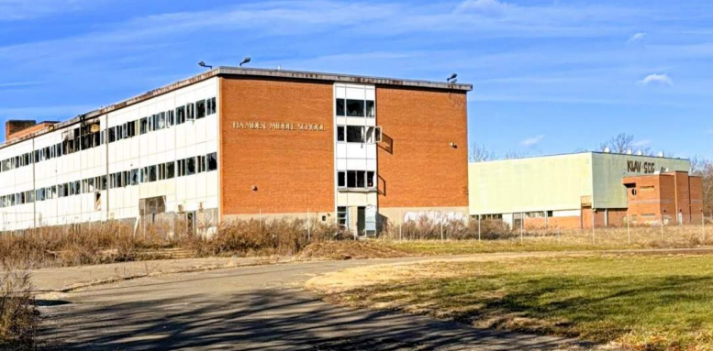
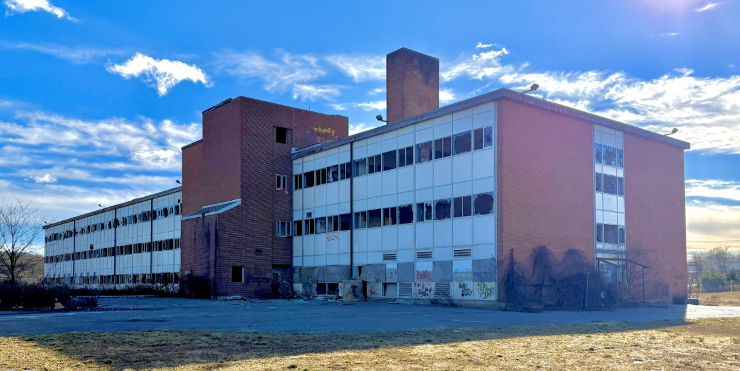
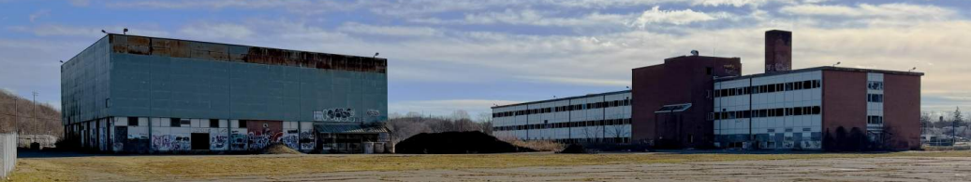
MIDDLE SCHOOL DEMOLITION PROJECT
SAM HAYDOCK, LEP
Project Manager
BL Companies
TIM BARRY
Project Manager
7 Summits Construction
Notes:
2 Minutes – BL – BL role, scope of project and your role on it, the status of your work

Slide 22
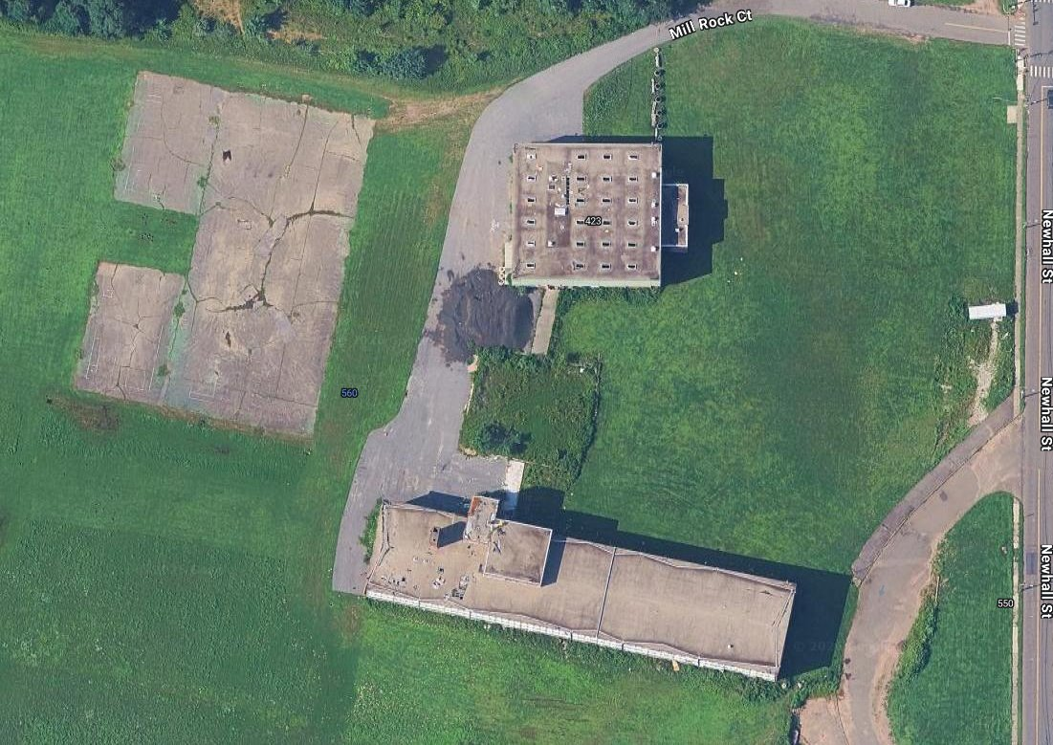
MIDDLE SCHOOL DEMOLITION PROJECT
SAM HAYDOCK, LEP
Project Manager
BL Companies
  Finalizing Plans, Specifications & Bid Documents
  Bidding and Contractor Selection
  Complete Abatement, Demolition & Restoration
  Field Oversight & Dust Monitoring Program
Notes:
5 Minutes – BL – BL role, scope of project and your role on it, the status of your work

Slide 23
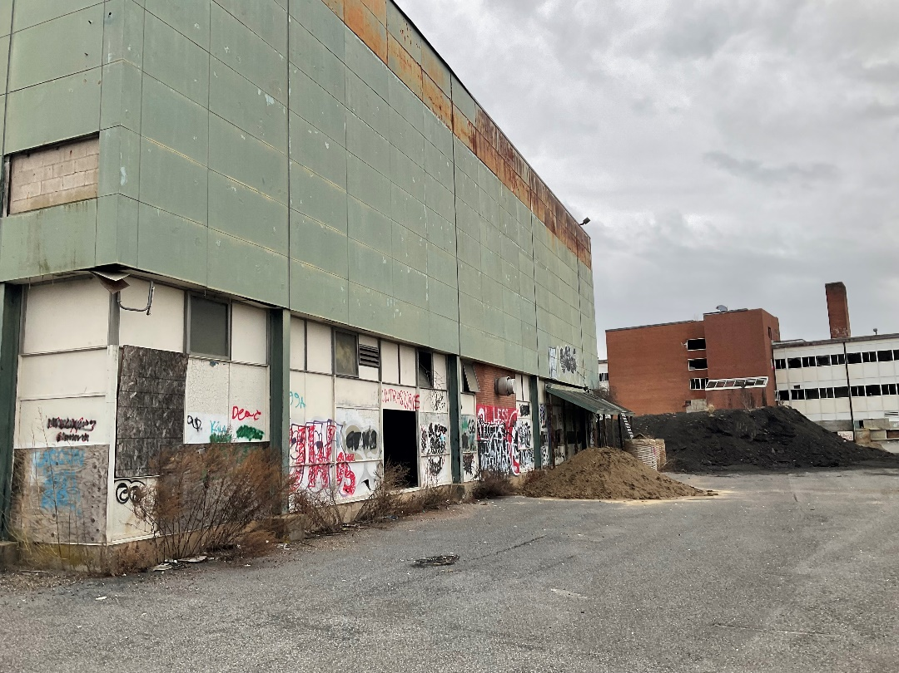
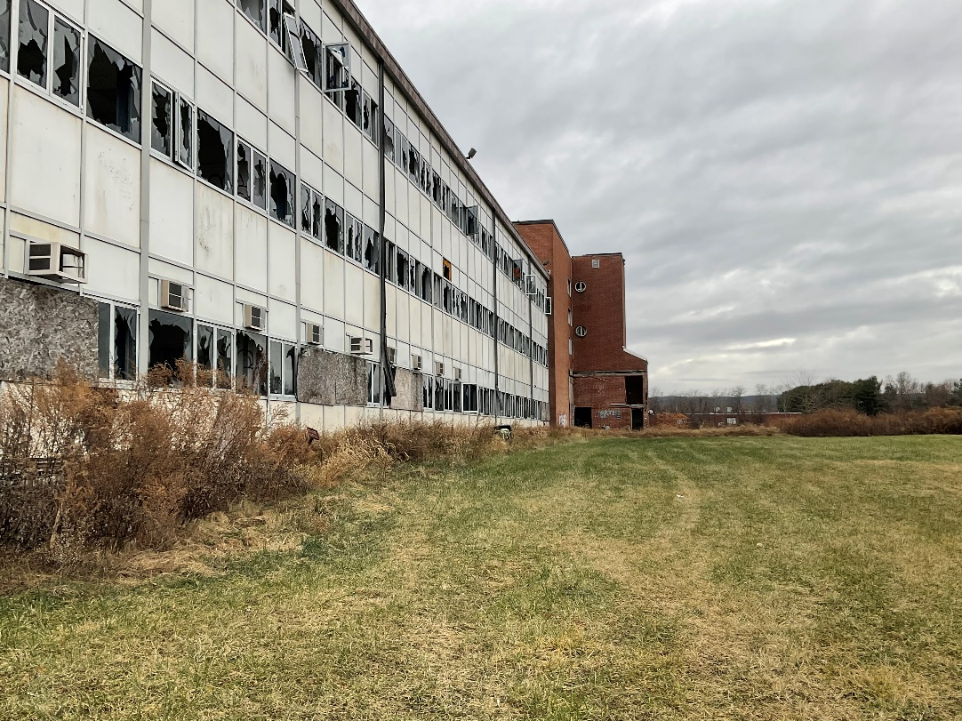
MIDDLE SCHOOL DEMOLITION PROJECT
TIM BARRY
Project Manager
7 Summits Construction
Current Activities
Logistics Plan
Next Steps
Notes:
2 Minutes – 7SC – 7SC role, our process for communication, homeowner considerations and plans, phasing,

Slide 24
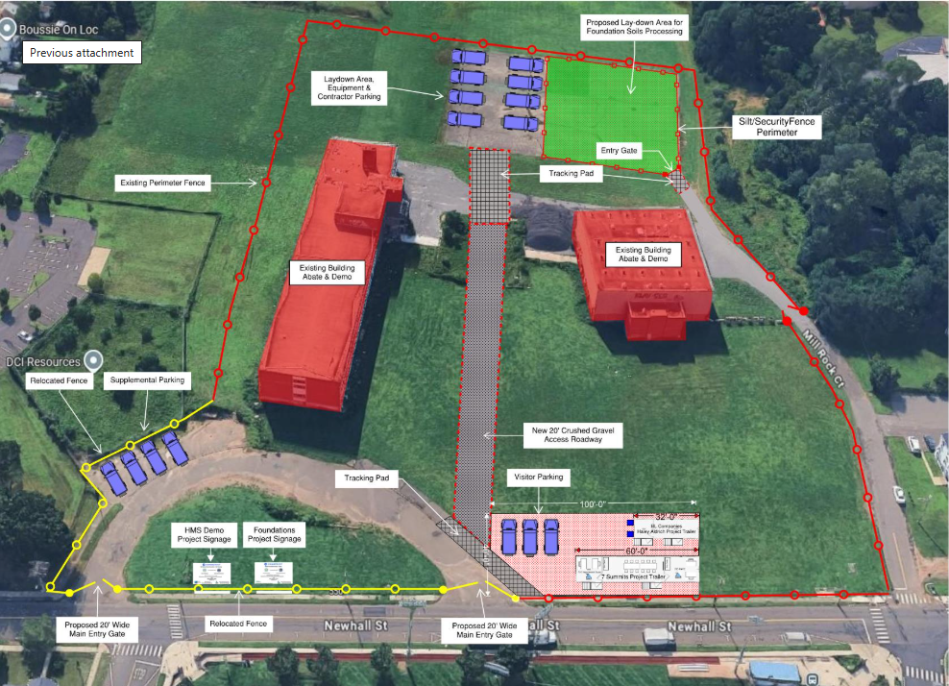
MIDDLE SCHOOL DEMOLITION PROJECT
Current Activities & Logistics Plan
TIM BARRY
Project Manager
7 Summits Construction
PROPOSED LAYDOWN AREA
LAYDOWN AREA, EQUIPMENT & CONTRACTOR PARKING
SECURITY FENCE PERIMETER
ENTRY GATE
EXISTING PERIMETER FENCE
TRACKING PAD
EXISTING BUILDING ABATE & DEMO
EXISTING BUILDING ABATE & DEMO
RELOCATED FENCE
SUPPLEMENTAL PARKING
NEW 20’ CRUSHED GRAVEL ACCESS ROADWAY
TRACKING PAD
VISITOR PARKING
HMS DEMO PROJECT SIGNAGE
FOUNDATIONS PROJECT SIGNAGE
PROPOSED 20’ WIDE MAIN ENTRY GATE
RELOCATED FENCE
PROPOSED 20’ WIDE MAIN ENTRY GATE
Notes:
3 Minutes – 7SC – 7SC role, our process for communication, homeowner considerations and plans, phasing,

Slide 25
MIDDLE SCHOOL DEMOLITION PROJECT
Schedule
TIM BARRY
Project Manager
7 Summits Construction
  Finalizing Plans, Specifications & Bid Documents
    March 2026
  Bidding and Contractor Selection
    6 Weeks after Final Drawings
  Complete Abatement, Demolition & Restoration
    6 Months from Contract Award by Town
WHAT WILL THE SITE BE LIKE WHEN COMPLETE?
Restored to Grade
Seeded
Pavement Left in Place
Clean and Safe
Notes:
3 Minutes – 7SC – 7SC role, our process for communication, homeowner considerations and plans, phasing,

Slide 26


Q&A
  Survey Questions will be answered first.
  Questions submitted this evening will be answered next.
  Questions from the floor will be limited to 3 minutes to encourage participation.
  Unanswered questions will be addressed at next community meeting.
  Additional questions may be emailed to hnnassoc@gmail.com
  To receive a home assessment please see Leah Berlin at back table or lberlin@haleyaldrich.com.
Notes:
5 Minutes – HNNA opens it up for questions

Slide 27
2026 Community Meeting Dates
Thursday, April 23, 2026,
Thursday, July 23, 2026
Thursday, October 29, 2026
Meetings begin at 6:30 PM
Locations TBD
Notes:
5 Minutes – HNNA opens it up for questions

